Slide 1


DESIGN 1
Lesson 2: Guided Practice: Building a Structured Page
Ms. Abboud • Grade 9 - Design 1 • Term 1, Week 3

Slide 2
Learning Objectives
WALT - We Are Learning To
WILF - What I'm Looking For
Apply headings and paragraphs to build a structured content page, with support.
Use <strong> and <em> to format text based on meaning, not just looks.
Can add a main heading (h1) and at least two sections (h2 + paragraph each).
Can use <strong> and <em> at least once, appropriately.

Slide 3
Academic Vocabulary
Strong
Emphasis
The <strong> tag - marks text as important, and browsers usually show it in bold.
The <em> tag - marks text as emphasized, and browsers usually show it in italics.
Semantic
Describing HTML chosen for its meaning (e.g. <strong> = important), not just how it looks.

Slide 4
Frayer Model: Semantic
DEFINITION
CHARACTERISTICS
HTML chosen because of what it means, not just how it happens to look on the page.
<strong> means important; <em> means emphasized. Bold/italic styling is a side effect, not the point.
SEMANTIC
EXAMPLES
NON-EXAMPLES
<strong>Design</strong> - marks 'Design' as genuinely important.
Using bold text purely to make a word look bigger, with no real meaning behind it.

Slide 5
National Identity Integration
Effective Digital Communication: choosing tags for their meaning, not just their appearance, is exactly the kind of careful, professional digital communication expected in UAE government and business websites.

Slide 6
STARTER
Quick Recap
Order the heading tags h1 through h6, from most to least important.
Cold call three students to check.
Hook • Engage & Ask
5 - 10 minutes

Slide 7
LESSON CORE
I Do: Teacher Demo
Watch: adding a new section (heading + paragraph) to a sample page, live.
Then: <strong> and <em> - used for meaning, not just bold/italic style.
Gradual Release of Responsibility
30 - 40 minutes
Example: a section using <strong> and <em>
<h2>My Favorite Subject</h2>
<p>My favorite subject is
<strong>Design</strong>, because I get to
<em>build real things</em> with code.</p>
1 / 3

Slide 8
LESSON CORE
We Do: Build Together, Checkpoint by Checkpoint
Checkpoint 1: add an h1 main heading and an introductory paragraph.
Checkpoint 2: add at least two more sections, each with an h2 and a paragraph.
Use the Checkpoint Sheet to track your progress as you go.
Gradual Release of Responsibility
30 - 40 minutes
2 / 3

Slide 9
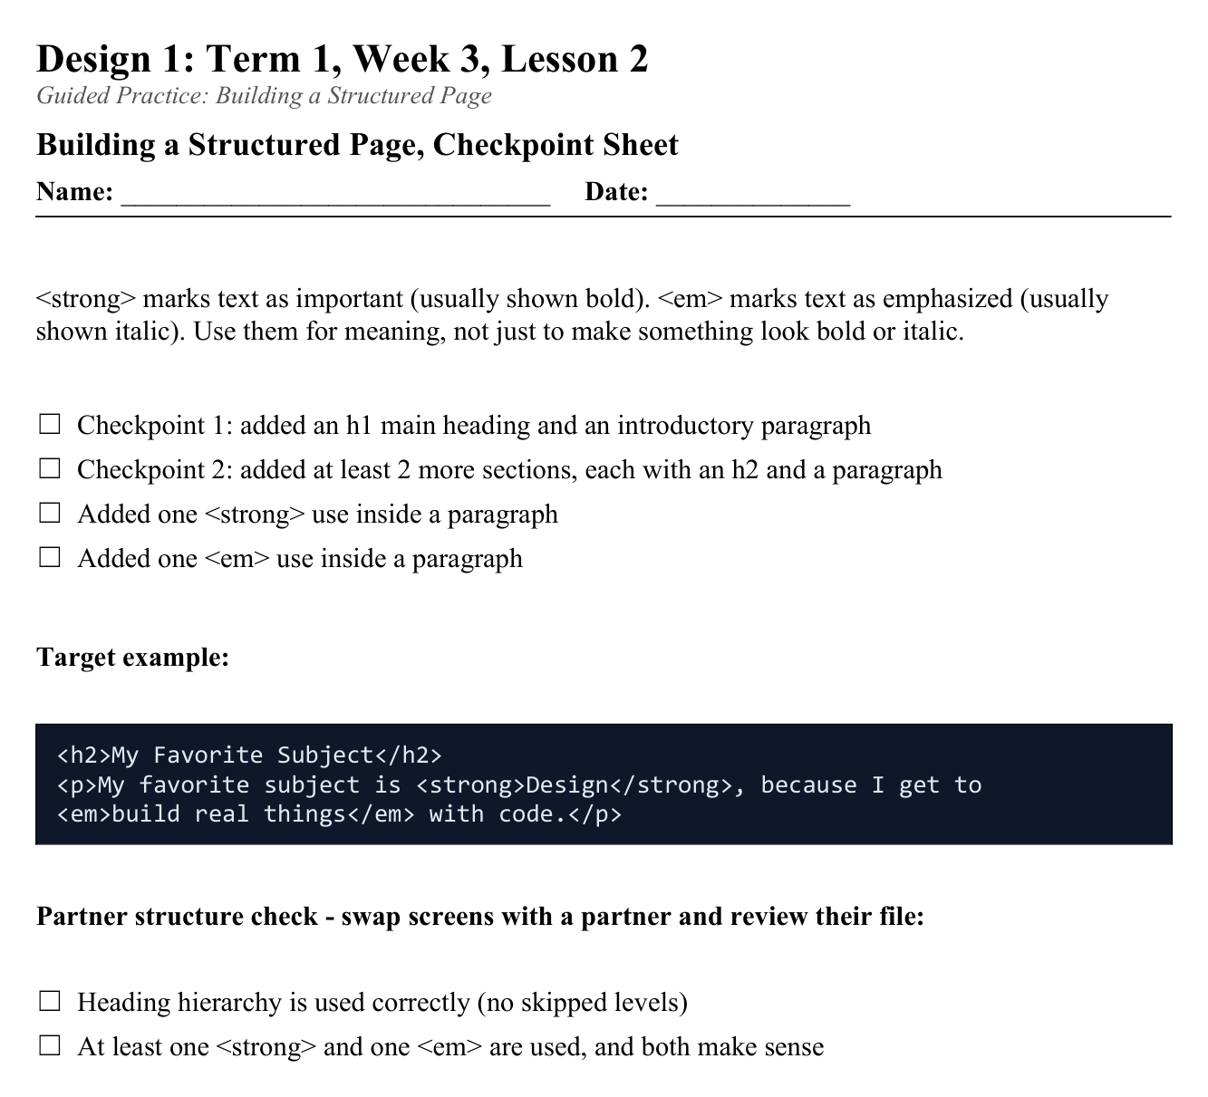
LESSON CORE
You Do: Add Strong & Em
Add one <strong> and one <em> inside your paragraphs - used semantically, not randomly.
Activity: Building a Structured Page, Checkpoint Sheet
Gradual Release of Responsibility
30 - 40 minutes
3 / 3

Slide 10
CLOSURE
Partner Check
Swap with a partner: does their page make sense just from reading the headings alone?
Give one piece of feedback before we close.
Transition & Extend
5 - 10 minutes

